Slide 1
CONTENTS
01. INTRODUCTION
02. WHAT IS CRISPR? 03. CRISPR APPLICATIONS 04. CRISPR MECHANISM
05. DESIGNING gRNAs 06. GENE EDITING 07. ANALYZING RESULTS 08. LIMITATIONS & CONS 09. REFERENCES
Every cell in our body contains a copy of our genome, over 20,000 genes, 3 billion letters of DNA.
DNA consists of two strands, twisted into a double helix and held together by a simple pairing rule. A pairs with T, and G pairs with C.
Our genes shape who we are as individuals and as a species.
Notes:
Every cell in our body contains a copy of our genome, over 20,000 genes, 3 billion letters of DNA. DNA consists of two strands, twisted into a double helix and held together by a simple pairing rule. A pairs with T, and G pairs with C. Our genes shape who we are as individuals and as a species.

Slide 2
CONTENTS
01. INTRODUCTION
02. WHAT IS CRISPR? 03. CRISPR APPLICATIONS 04. CRISPR MECHANISM
05. DESIGNING gRNAs 06. GENE EDITING 07. ANALYZING RESULTS 08. LIMITATIONS & CONS 09. REFERENCES
Genes also have profound effects on health, and thanks to advances in DNA sequencing, researchers have identified thousands of genes that affect our risk of disease.
To understand how genes work, researchers need ways to control them. Changing genes in living cells is not easy.
But recently a new method has been developed that promises to dramatically improve our ability to edit the DNA of any species, including humans.
Notes:
Genes also have profound effects on health, and thanks to advances in DNA sequencing, researchers have identified thousands of genes that affect our risk of disease. To understand how genes work, researchers need ways to control them. Changing genes in living cells is not easy, but recently a new method has been developed that promises to dramatically improve our ability to edit the DNA of any species, including humans.

Slide 3

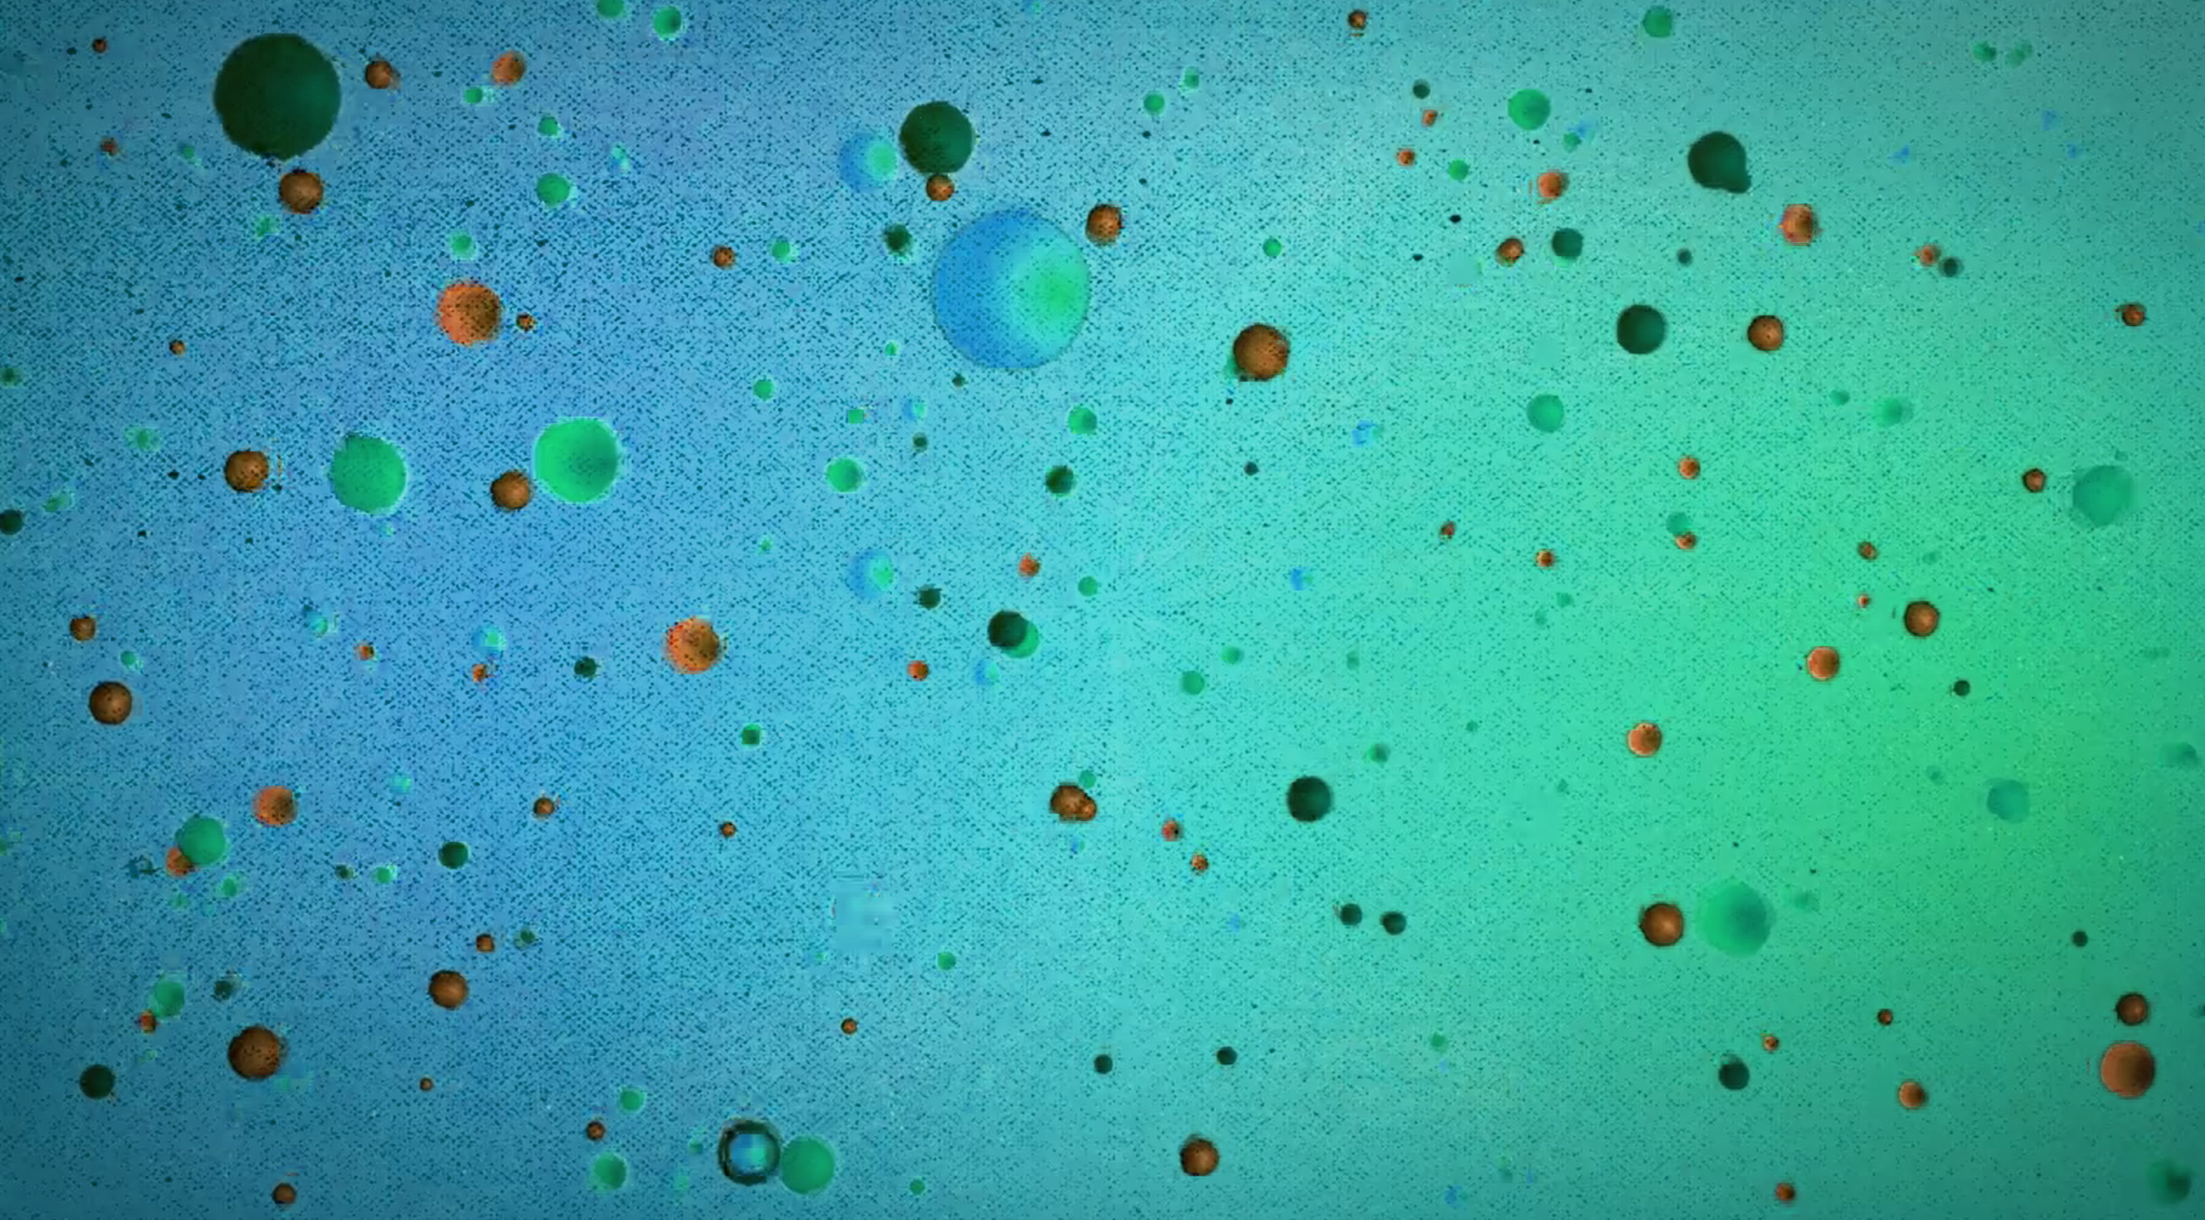
CRISPR
CRISPR
GENE MODIFICATION USING CRISPR TECHNOLOGY YAMEN ZAKHOUR & LEYAN AWWAD U15102342 – U15102161
Notes:
Introducing CRISPR, a system that has revolutionized the field of genome engineering with limitless applications in disease therapeutics, drug discovery, agriculture, biofuels, and much more. This revolutionary breakthrough has completely change the way science is performed, and it will soon change many aspects of our everyday lives.

Slide 4
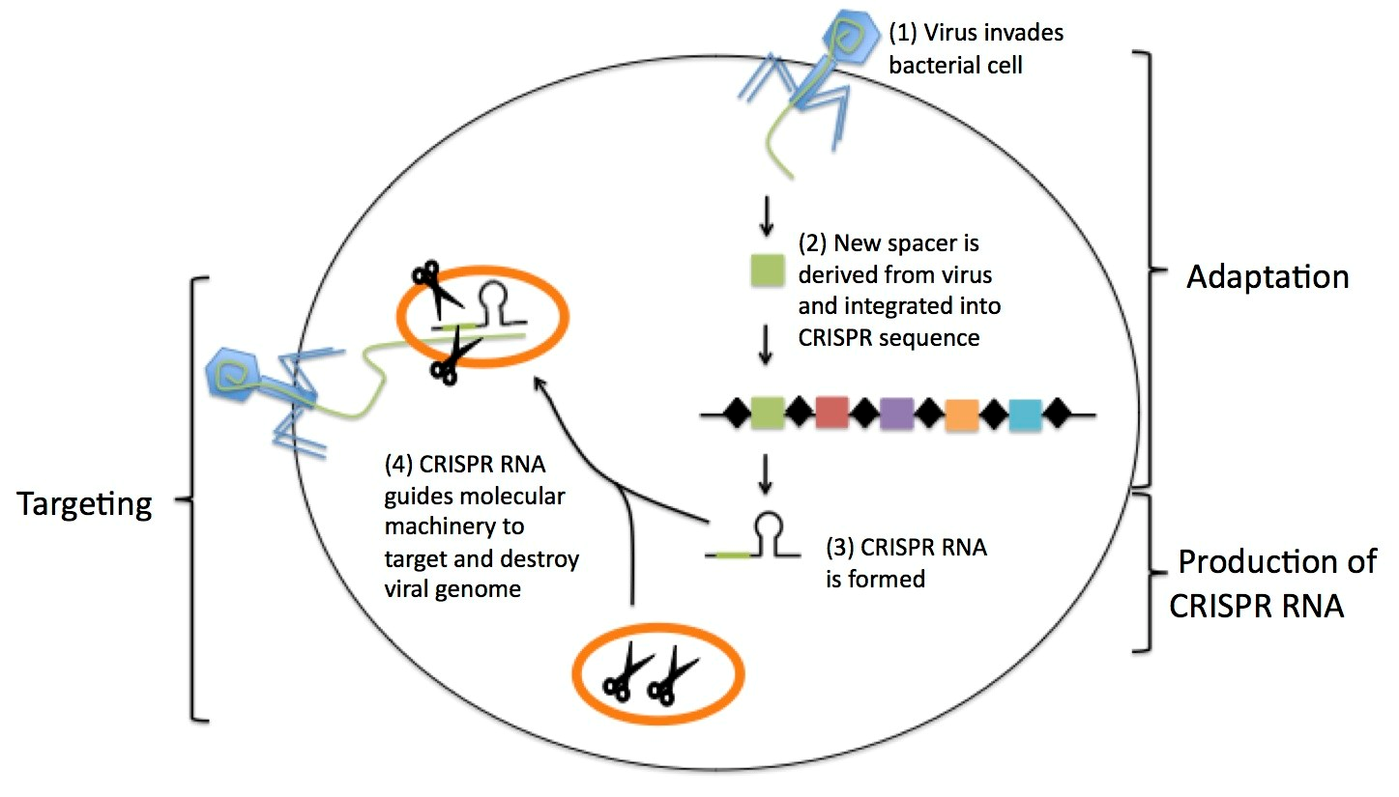
WHAT IS CRISPR?
CONTENTS
CRISPR is an acronym for “Clustered Regularly Interspaced Short Palindromic Repeats.” CRISPR genome engineering technology enables scientists to easily and precisely edit the DNA of any genome.
In nature, the CRISPR palindromic repeats play an important role in microbial immunity. 1. Virus infects a microbial cell 2. Microbe employs a special CRISPR-associated nuclease (Cas9) to chop off a piece of the viral DNA. 3. The nuclease is directed to its target sequence by a short RNA fragment known as a guide RNA (gRNA), which is complementary to the target segment of the viral genome. 4. The snipped DNA fragment may then be stored between the palindromic CRISPR sequences to retain a genetic memory for disabling future infections from the same viral strain.
01. INTRODUCTION
02. WHAT IS CRISPR? 03. CRISPR APPLICATIONS 04. CRISPR MECHANISM
05. DESIGNING gRNAs 06. GENE EDITING 07. ANALYZING RESULTS 08. LIMITATIONS & CONS 09. REFERENCES
Notes:
What is CRISPR?
CRISPR is an acronym for “Clustered Regularly Interspaced Short Palindromic Repeats.” CRISPR genome engineering technology enables scientists to easily and precisely edit the DNA of any genome.
In nature, the CRISPR palindromic repeats play an important role in microbial immunity. When a virus infects a microbial cell, the microbe employs a special CRISPR-associated nuclease (Cas9) to chop off a piece of the viral DNA. The nuclease is directed to its target sequence by a short RNA fragment known as a guide RNA (gRNA), which is complementary to the target segment of the viral genome. The snipped DNA fragment may then be stored between the palindromic CRISPR sequences to retain a genetic memory for disabling future infections from the same viral strain.
Once scientists learned how the CRISPR system worked in bacteria, they figured out how to reprogram it to allow efficient editing in any species.

Slide 5
DEFINITION
CONTENTS
CRISPR gene editing
CRISPR gene editing is a genetic engineering technique in molecular biology by which the genomes of living organisms may be modified. It is based on a simplified version of the bacterial CRISPR antiviral defense system. By delivering the Cas9 nuclease complexed with a synthetic guide RNA (gRNA) into a cell, the cell's genome can be cut at a desired location, allowing existing genes to be removed and/or new ones added in vivo.
01. INTRODUCTION
02. WHAT IS CRISPR? 03. CRISPR APPLICATIONS 04. CRISPR MECHANISM
05. DESIGNING gRNAs 06. GENE EDITING 07. ANALYZING RESULTS 08. LIMITATIONS & CONS 09. REFERENCES
Notes:
To conclude a definition; CRISPR gene editing is a genetic engineering technique in molecular biology by which the genomes of living organisms may be modified. It is based on a simplified version of the bacterial CRISPR antiviral defense system. By delivering the Cas9 nuclease complexed with a synthetic guide RNA (gRNA) into a cell, the cell's genome can be cut at a desired location, allowing existing genes to be removed and/or new ones added in vivo.

Slide 6
CRISPR APPLICATIONS
CONTENTS
CRISPR has already shown promising results for treating several diseases and has also had a huge impact in editing plant genomes, facilitating several beneficial agricultural applications. The CRISPR technology has also shown potential in other areas such as developing disease models and biofuels.
01. INTRODUCTION
02. WHAT IS CRISPR? 03. CRISPR APPLICATIONS 04. CRISPR MECHANISM
05. DESIGNING gRNAs 06. GENE EDITING 07. ANALYZING RESULTS 08. LIMITATIONS & CONS 09. REFERENCES
During the past years, the technology has been used to
Functionally inactivate genes in human cell lines and cells
Study Candida albicans
Modify yeasts used to make biofuels
Genetically modify crop strains.
Studies on changing mosquitos so they cannot transmit diseases such as malaria.
CRISPR based approaches utilizing Cas12a have recently been utilized in the successful modification of a broad number of plant species.
In July 2019, doctors in Tennessee, United States, used CRISPR to experimentally treat a patient with a genetic disorder. The patient was a 34-year-old woman with sickle cell disease
In the future, CRISPR gene editing could be used to create new species or revive extinct species from closely related ones.
Notes:
CRISPR has already shown promising results for treating several diseases and has also had a huge impact in editing plant genomes, facilitating several beneficial agricultural applications. The CRISPR technology has also shown potential in other areas such as developing disease models and biofuels.
During the past years, the technology has been used to
Functionally inactivate genes in human cell lines and cells
Study Candida albicans
Modify yeasts used to make biofuels
Genetically modify crop strains.
Studies on changing mosquitos so they cannot transmit diseases such as malaria.
CRISPR based approaches utilizing Cas12a have recently been utilized in the successful modification of a broad number of plant species.
In July 2019, doctors in Tennessee, United States, used CRISPR to experimentally treat a patient with a genetic disorder. The patient was a 34-year-old woman with sickle cell disease
In the future, CRISPR gene editing could be used to create new species or revive extinct species from closely related ones.

Slide 7
CRISPR MECHANISM
CONTENTS
The beauty of CRISPR lies in its simplicity. CRISPR relies on just two components:
Molecular Scissors, a CRISPR-associated (Cas) nuclease.
The GPS guiding it to the appropriate site, the guide RNA (gRNA).
In natural, the gRNA consists of two distinct segments of RNA: CRISPR RNA (crRNA) and transactivating CRISPR RNA (tracrRNA). Synthetically, they can be engineered as one seamless fusion sequence known as single guide RNA (sgRNA). Why do we want it?
Improved Editing Efficiency: The editing efficiency in cells transfected with synthetic sgRNA has been experimentally confirmed to be higher than that of non-synthetically derived sgRNA.
Minimum Risk Delivery System: The continual expression of guide RNAs inside the cell could result in unwanted effects in random or unexpected places in the genome. Introducing the CRISPR machinery in the ribonucleoprotein format into cells alleviates these concerns as the RNP exists transiently inside the cell and shows reduced toxicity and off-target effects.
Increased Experimental Convenience: Even if an experiment is complicated, its preparation does not need to be.
Compatibility With Chemically Modified Guides
01. INTRODUCTION
02. WHAT IS CRISPR? 03. CRISPR APPLICATIONS 04. CRISPR MECHANISM
05. DESIGNING gRNAs 06. GENE EDITING 07. ANALYZING RESULTS 08. LIMITATIONS & CONS 09. REFERENCES
Notes:
The beauty of CRISPR lies in its simplicity. CRISPR relies on just two components:
1) Molecular Scissors, a CRISPR-associated (Cas) nuclease. 2) The GPS guiding it to the appropriate site, the guide RNA (gRNA).
In natural, the gRNA consists of two distinct segments of RNA: CRISPR RNA (crRNA) and transactivating CRISPR RNA (tracrRNA). Synthetically, they can be engineered as one seamless fusion sequence known as single guide RNA (sgRNA).
In natural, the gRNA consists of two distinct segments of RNA: CRISPR RNA (crRNA) and transactivating CRISPR RNA (tracrRNA). Synthetically, they can be engineered as one seamless fusion sequence known as single guide RNA (sgRNA). Why do we want it?
Improved Editing Efficiency: The editing efficiency in cells transfected with synthetic sgRNA has been experimentally confirmed to be higher than that of non-synthetically derived sgRNA.
Minimum Risk Delivery System: The continual expression of guide RNAs inside the cell could result in unwanted effects in random or unexpected places in the genome. Introducing the CRISPR machinery in the ribonucleoprotein format into cells alleviates these concerns as the RNP exists transiently inside the cell and shows reduced toxicity and off-target effects.
Increased Experimental Convenience: Even if an experiment is complicated, its preparation does not need to be.
Compatibility With Chemically Modified Guides

Slide 8


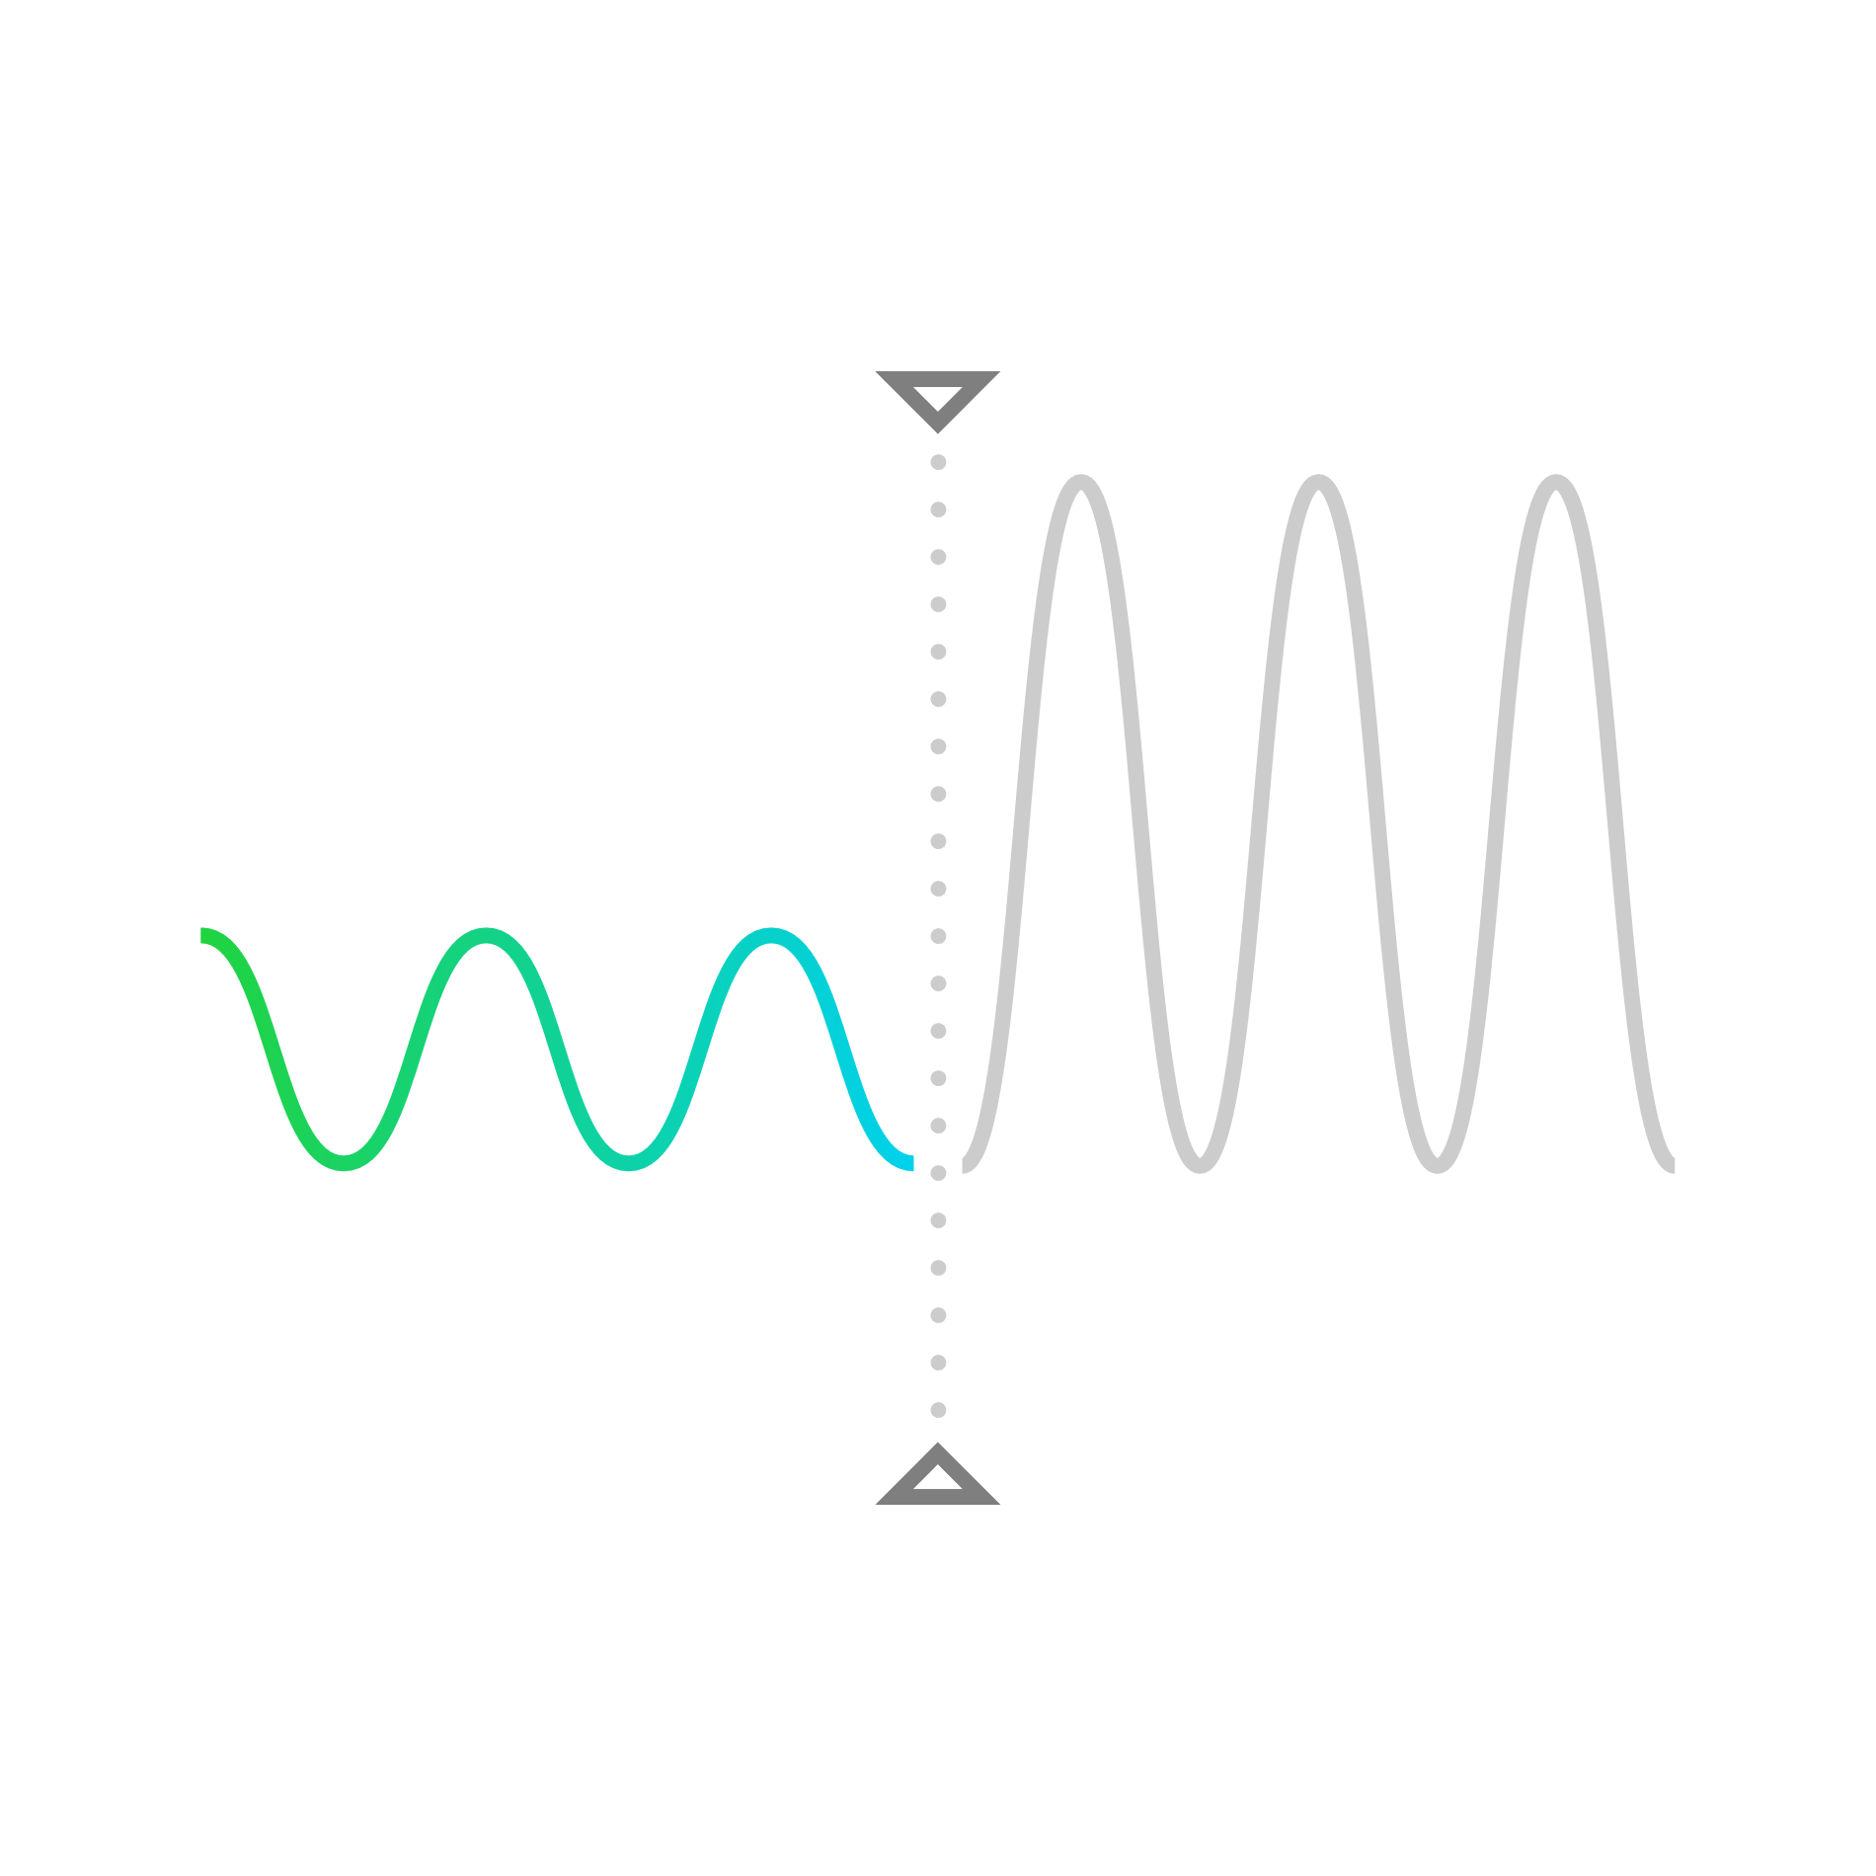
HOW TO USE CRISPR
STEP 1
STEP 2
STEP 3
Design CRISPR’s sgRNA
Edit DNA Precisely with CRISPR
Analyze Data from Experiment
Notes:
Successfully incorporating CRISPR into your research involves several steps: selecting the correct components to achieve your experimental goals, introducing these components into cells to perform the editing, and analyzing the results of the CRISPR experiments. Broadly, these steps can be categorized under design, edit, and analyze. First, let’s explore how to design guide RNAs for CRISPR

Slide 9
STEP 1: DESIGNING gRNA
CONTENTS
Choose the best CRISPR gRNA design tool, from the market, according to the type of research you are holding. The following are the most common types CRISPR is used in:
Designing gRNA for Gene Knockouts
Most widely adopted use of CRISPR is to knock out (KO) specific genes in the genome of an organism to test their function. A successful genetic knockout generally results in a loss of protein function and often (but not always) manifests as a change in phenotype.
Designing gRNA for Gene Knock-ins
A knock-in (KI) experiment aims to edit the target genome by inserting a new DNA fragment into the genome. In this case, we divert the cell from using its Non-homologous end joining (NHEJ) repair pathway (which repairs double-strand breaks in DNA) to another more sophisticated repair pathway, referred to as the homology-directed repair (HDR) pathway. In HDR, the cell copies the sequence of a donor DNA template to fill in the broken piece accurately. In knock-in experiments, researchers supply a surplus of template DNA bearing their desired genomic change, improving their chances that the cell will pick this DNA to use for the repair.
Designing gRNA for CRISPRA (Activator) and CRISPRI (Inhibitor)
These experiments involve gene activation or inhibition by targeting the promoter of the target gene. The location target DNA range for guide RNA is therefore quite narrow, necessitating a balance of complementary sequence and optimized location while designing.
While designing, ensure the on-target activity of the gRNA and try to minimize most of its off-target effects.
01. INTRODUCTION
02. WHAT IS CRISPR? 03. CRISPR APPLICATIONS 04. CRISPR MECHANISM
05. DESIGNING gRNAs 06. GENE EDITING 07. ANALYZING RESULTS 08. LIMITATIONS & CONS 09. REFERENCES
Notes:
Choose the best CRISPR gRNA design tool, from the market, according to the type of research you are holding. The following are the most common types CRISPR is used in: Designing gRNA for Gene Knockouts Most widely adopted use of CRISPR is to knock out (KO) specific genes in the genome of an organism to test their function. A successful genetic knockout generally results in a loss of protein function and often (but not always) manifests as a change in phenotype. Designing gRNA for Gene Knock-ins A knock-in (KI) experiment aims to edit the target genome by inserting a new DNA fragment into the genome. In this case, we divert the cell from using its Non-homologous end joining (NHEJ) repair pathway (which repairs double-strand breaks in DNA) to another more sophisticated repair pathway, referred to as the homology-directed repair (HDR) pathway. In HDR, the cell copies the sequence of a donor DNA template to fill in the broken piece accurately. In knock-in experiments, researchers supply a surplus of template DNA bearing their desired genomic change, improving their chances that the cell will pick this DNA to use for the repair.
Designing gRNA for CRISPRA (Activator) and CRISPRI (Inhibitor) These experiments involve gene activation or inhibition by targeting the promoter of the target gene. The location target DNA range for guide RNA is therefore quite narrow, necessitating a balance of complementary sequence and optimized location while designing.
While designing, ensure the on-target activity of the gRNA and try to minimize most of its off-target effects.

Slide 10
STEP 2: GENE EDITING
CONTENTS
Once the sgRNA is designed and synthesized, you can precisely edit the desired DNA sequence in any genome. Depending on the application and specific experimental needs, a variety of alternative nucleases exist for every job.
Note: you need to ensure that the sequence you want to edit contains the PAM (Protospacer Adjacent Motif) sequence that the nuclease absolutely needs to cut.
Cas9: The Workhorse CRISPR-Associated Nuclease
Cas9 is currently the most widely known nuclease in CRISPR experiments, specifically the Cas9 variant isolated from the bacterium Streptococcus pyogenes (SpCas9). Once Cas9 recognizes the PAM sequence (5’-NGG-3 in case of SpCas9, where N is any nucleotide), it creates a double-strand break (DSB) at the target locus. Cas9 activity is a collective effort of two parts of the protein: the recognition lobe and the nuclease lobe. One senses the complementary DNA sequence, and the other has nuclease domains which cleave the DNA.
Cas9 Alternatives
CasX, CasY, Cas12a (Cpf1), Cas14a, High-Fidelity Cas9, eSpCas9, SpCas9-HF1, HypaCas9, FokI-Fused dCas9, Catalytically Dead Cas9 (dCas9), xCas9: Expanded PAM Recognition.
01. INTRODUCTION
02. WHAT IS CRISPR? 03. CRISPR APPLICATIONS 04. CRISPR MECHANISM
05. DESIGNING gRNAs 06. GENE EDITING 07. ANALYZING RESULTS 08. LIMITATIONS & CONS 09. REFERENCES
Notes:
Once the sgRNA is designed and synthesized, you can precisely edit the desired DNA sequence in any genome. Depending on the application and specific experimental needs, a variety of alternative nucleases exist for every job.
Note: you need to ensure that the sequence you want to edit contains the PAM (Protospacer Adjacent Motif) sequence that the nuclease absolutely needs to cut.
Cas9: The Workhorse CRISPR-Associated Nuclease
Cas9 is currently the most widely known nuclease in CRISPR experiments, specifically the Cas9 variant isolated from the bacterium Streptococcus pyogenes (SpCas9). Once Cas9 recognizes the PAM sequence (5’-NGG-3 in case of SpCas9, where N is any nucleotide), it creates a double-strand break (DSB) at the target locus. Cas9 activity is a collective effort of two parts of the protein: the recognition lobe and the nuclease lobe. One senses the complementary DNA sequence, and the other has nuclease domains which cleave the DNA.
Some test requires a nuclease other than CAS9 here are the alternatives.

Slide 11
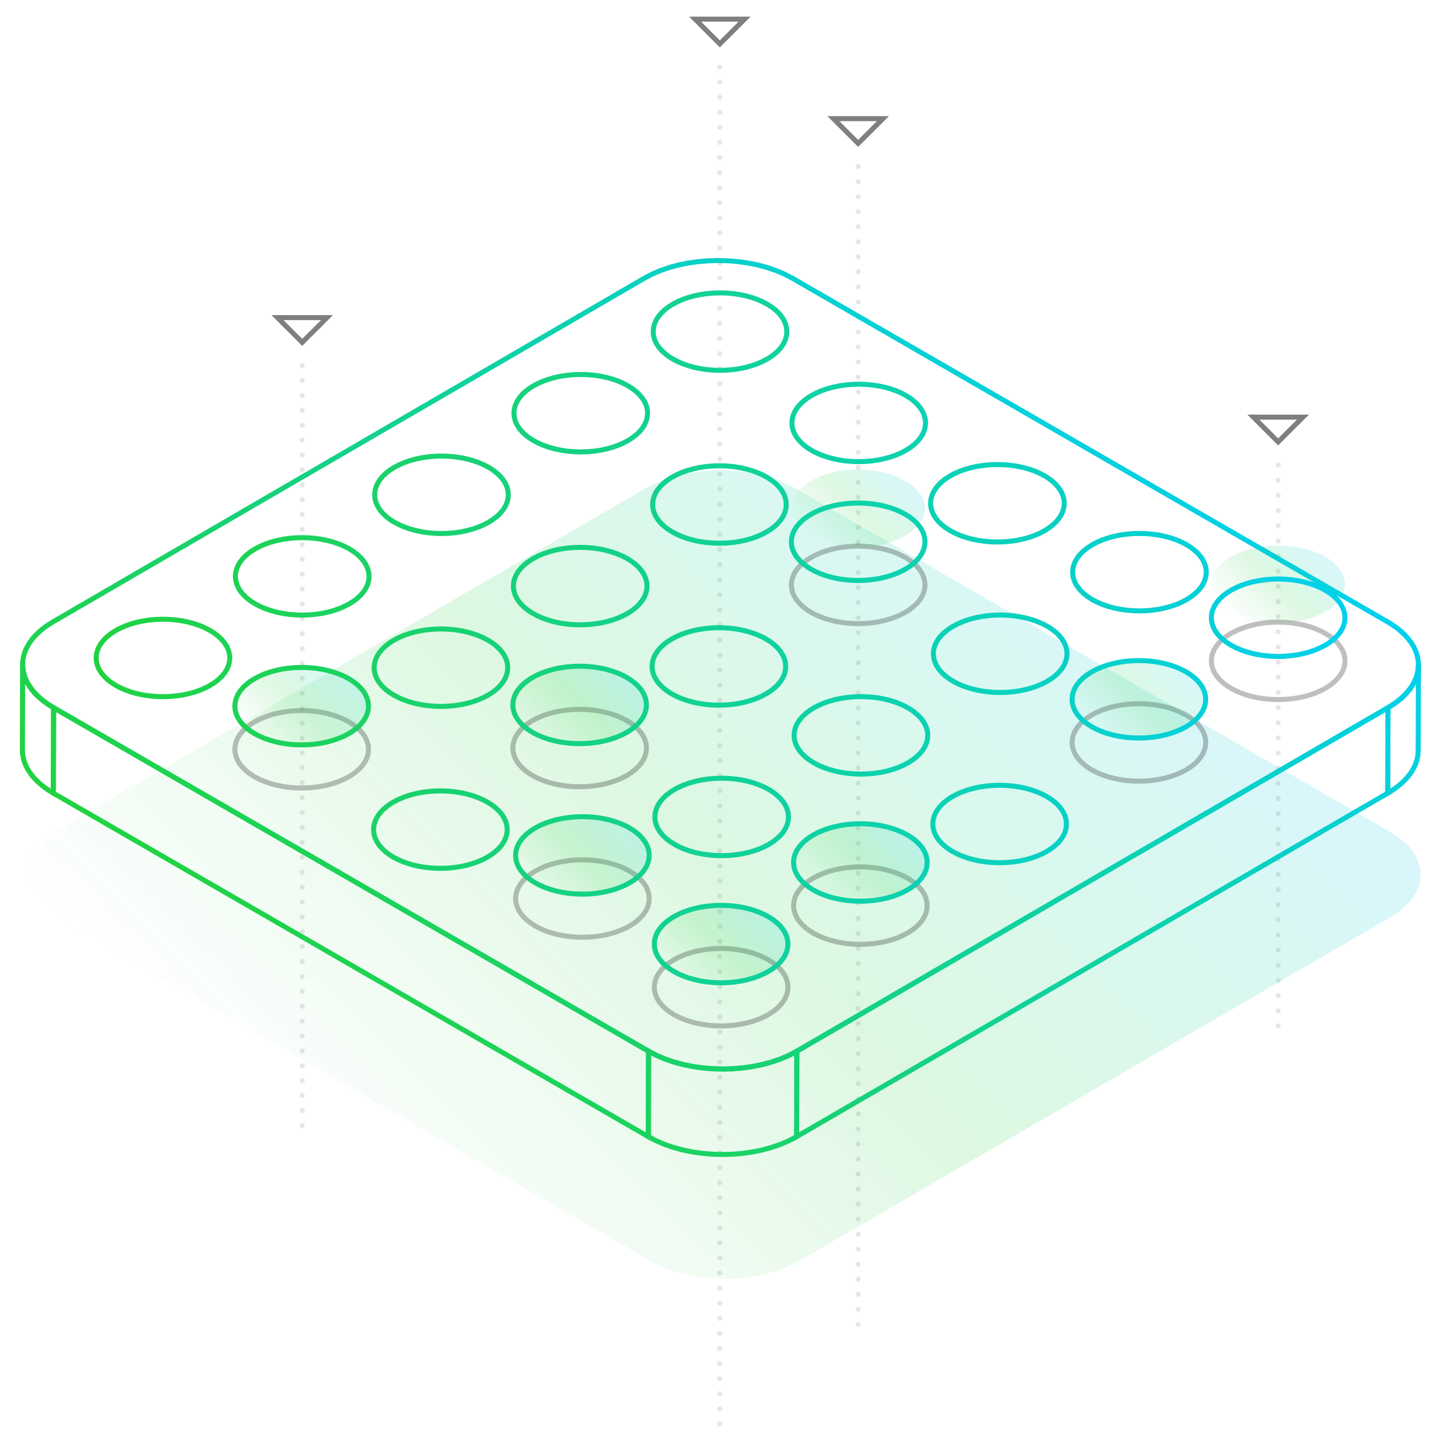
STEP 3: ANALYZING RESULTS
CONTENTS
The last step in the CRISPR workflow is to analyze the editing efficiency and to determine the DNA sequences at your target region after being edited. You picked the best sgRNA and used an optimum transfection method, and now you need to review the quality of your editing and make plans for what comes next! Choosing an accurate analysis method and using it efficiently are essential factors influencing the success of the test.
Recent advances made analyzing easier using computers and software, for instance ICE analyses data based on a knock-out and knock-in scores.
01. INTRODUCTION
02. WHAT IS CRISPR? 03. CRISPR APPLICATIONS 04. CRISPR MECHANISM
05. DESIGNING gRNAs 06. GENE EDITING 07. ANALYZING RESULTS 08. LIMITATIONS & CONS 09. REFERENCES
Notes:
The last step in the CRISPR workflow is to analyze the editing efficiency and to determine the DNA sequences at your target region after being edited. You picked the best sgRNA and used an optimum transfection method, and now you need to review the quality of your editing and make plans for what comes next! Choosing an accurate analysis method and using it efficiently are essential factors influencing the success of the test.
Recent advances made analyzing easier using computers and software, for instance ICE analyses data based on a knock-out and knock-in scores.

Slide 12
LIMITATIONS
CONTENTS
One potential limitation of CRISPR technology is that the approach may create off-target effects. These off-target effects might play a role in recognizing and destroying hypervariable viral nucleic acids or plasmid DNA, which is beneﬁcial to bacteria and archaea.
01. INTRODUCTION
02. WHAT IS CRISPR? 03. CRISPR APPLICATIONS 04. CRISPR MECHANISM
05. DESIGNING gRNAs 06. GENE EDITING 07. ANALYZING RESULTS 08. LIMITATIONS & CONS 09. REFERENCES
Notes:
One potential limitation of CRISPR technology is that the approach may create off-target effects. These off-target effects might play a role in recognizing and destroying hypervariable viral nucleic acids or plasmid DNA, which is beneﬁcial to bacteria and archaea.

Slide 13
REFERENCES
CONTENTS
https://www.ncbi.nlm.nih.gov/pmc/articles/PMC3981743/
https://academic.oup.com/nar/article/41/15/7429/2411254
https://old.abmgood.com/marketing/knowledge_base/CRISPR-Cas9-dCas9-Gene-Regulation.php
https://journals.plos.org/plosbiology/article?rev=2&id=10.1371/journal.pbio.2003213
https://www.sciencedirect.com/science/article/pii/S1934590916000230
https://fungalbiolbiotech.biomedcentral.com/articles/10.1186/s40694-015-0015-1
https://en.wikipedia.org/wiki/CRISPR_gene_editing
https://www.synthego.com/learn/crispr
https://www.wired.com/story/wired-guide-to-crispr/
https://www.youtube.com/watch?v=4YKFw2KZA5o
https://www.synthego.com/resources/crispr-101-ebook
https://www.synthego.com/guide/how-to-use-crispr/sgrna
https://www.youtube.com/watch?v=iSEEw4Vs_B4
https://en.wikipedia.org/wiki/CRISPR/Cas_Tools
https://www.synthego.com/guide/how-to-use-crispr/analysis-methods
01. INTRODUCTION
02. WHAT IS CRISPR? 03. CRISPR APPLICATIONS 04. CRISPR MECHANISM
05. DESIGNING gRNAs 06. GENE EDITING 07. ANALYZING RESULTS 08. LIMITATIONS & CONS 09. REFERENCES
Notes:
Thank you yebnl3rs

